Slide 1

CEIR Retailer Training Manual

Slide 2

Agenda
Retailer Definition and Overview
Assumptions
Features
Registration
Dashboard
Stock Management
Grievance
Profile Management

Slide 3
Retailer - Definition
Retailer is an entity that get the supply of SIM based devices from distributers.
Retailer do not interact with Customs directly for paying the import duty Retailer may or may not maintain the device details received from Distributer.
Retailers has to be legally registered entity with Department of Commerce (Government )
A Retailer can be Importer and Distributer as well.
Retailers are required to interface with CEIR system to report the inventory of devices during grace period. Retailer could do that anonymously as well during the grace period.
Retailers will interface with CEIR after the grace period to upload the stock. This interface is optional to use but built in the CEIR system.

Slide 4
Retailer - Overview
Retailer has to register using DMC Home Portal
As part of registration process, retailer will receive the username and password which can be then used to login to the CEIR Portal
Once logged into the CEIR portal, retailer can use following features
Stock Management
Grievance Management
Profile Management
Retailer can see the status of ongoing activity through the Dashboard feature
Email Notification to keep track of the status of various operations

Slide 5
Assumption
Following regulations will be implemented
For Retailers to register with CEIR system.
Companies that register as Retailer should have valid VAT registration.
Device upload based on the Invalid TAC information from the Retailers will be rejected.

Slide 6
Registration – Retailer
A Retailer can either be a Cambodian user only
A Retailer can register as
Individual → If registered as an Individual, National ID / Passport details are mandatory. Submission of VAT file is not mandatory in case of an Individual.
Company → If registered as a company, VAT details for the company are mandatory.

Slide 7
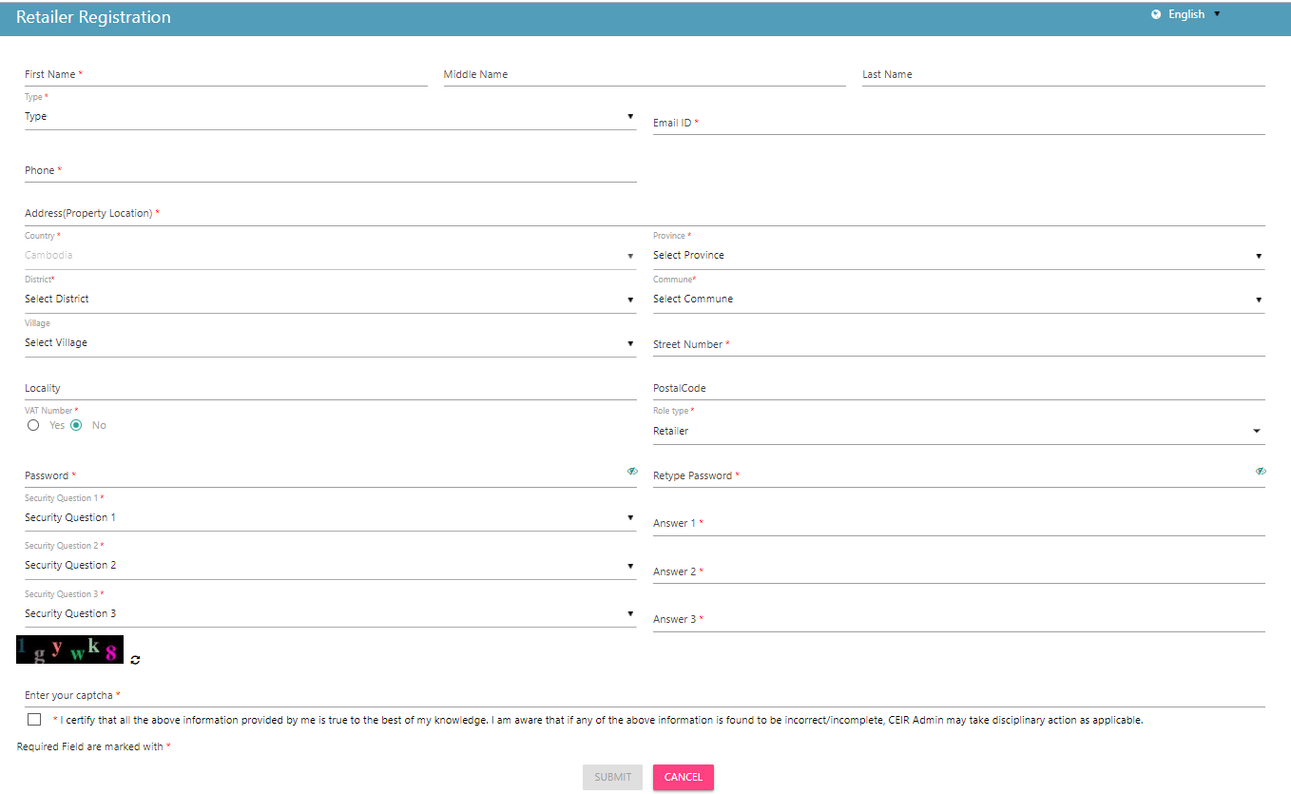
Registration – Retailer (Form)

Slide 8
Dashboard - Retailer
The Dashboard has information about the following
Stock requests uploaded by the Retailer
Total devices waiting for upload
Total Grievances raised by the Retailer
Notifications on feature requests raised by the Retailer

Slide 9
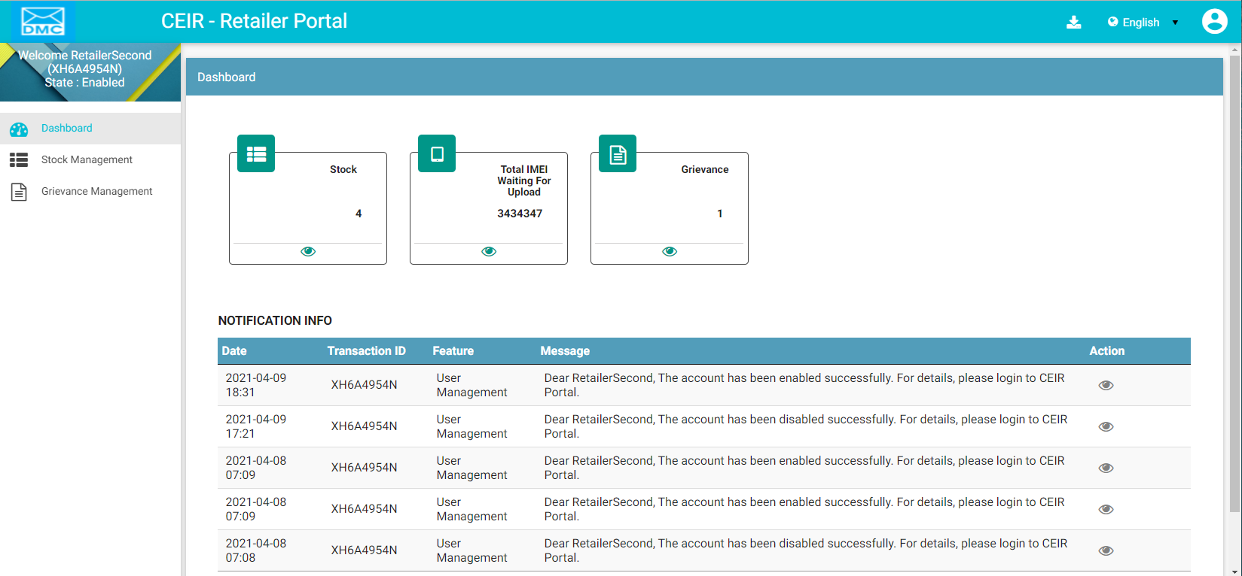
Dashboard – Retailer
Left Panel
Download User Manual
Work Area
All features status
Edit Profile
Language Change
Notifications
On click it takes user to respective home page

Slide 10
Stock Management – Retailer
Stock is uploaded to the system to be made available for sale.
Retailer can upload stock in grace period as well as after the grace period.

Slide 11
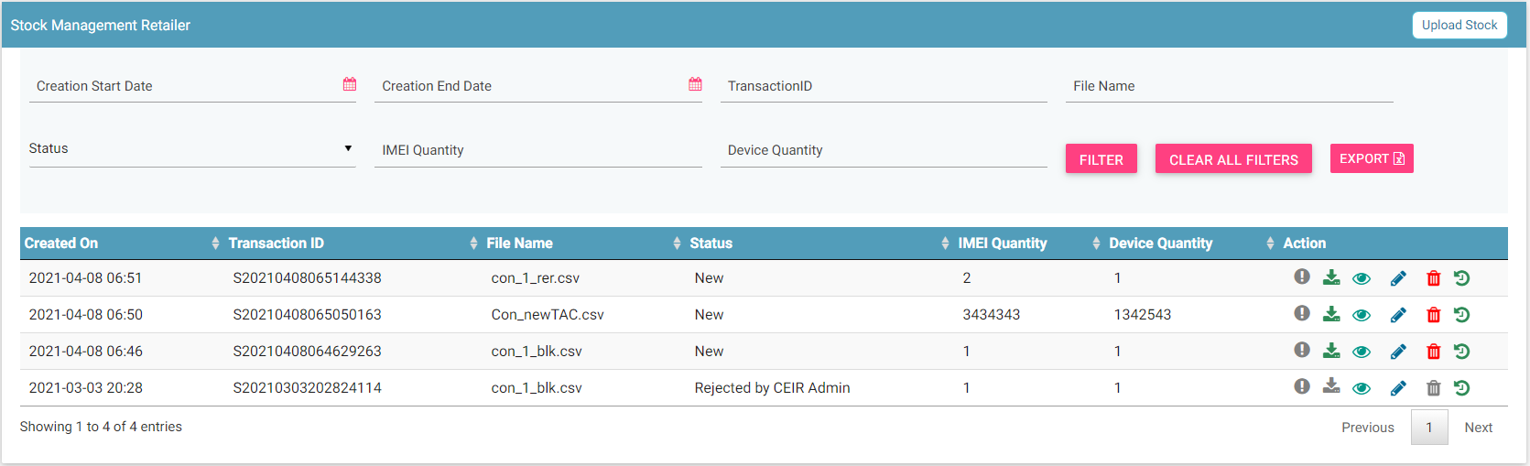
Stock Management – Retailer
Upload
Filters
Export
Action like View, Delete
View All Stocks

Slide 12
Grievance – Retailer
As a retailer, you can register grievances when there is a problem in the CEIR system.
For example, there could be situations when the registration feature is not working or there could be a problem in stock upload.
Once a grievance is raised, it reaches the CEIR Admin queue for response from CEIR Authority.
CEIR Admin can ask for more details in case required.
Else CEIR Admin will respond and close the grievance.

Slide 13
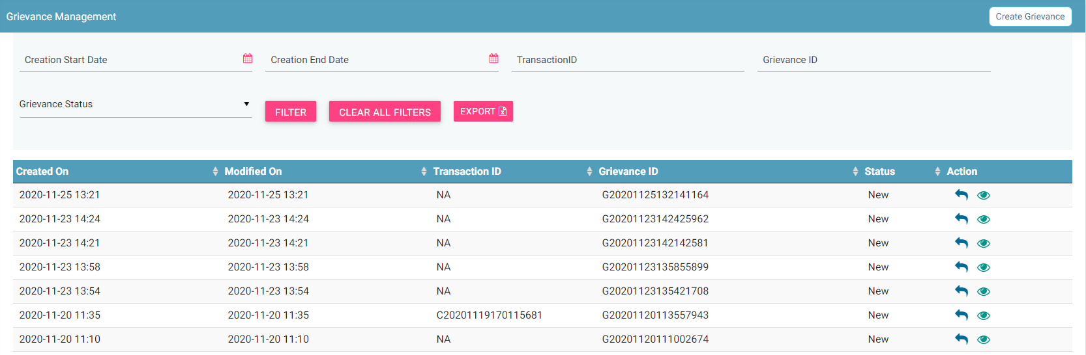
Grievance – Retailer
Report
Filters
Export
Action like View, Reply
View All grievances

Slide 14
Queries

Slide 15
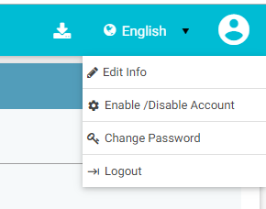
Profile Management – Manufacturer

Slide 16
Thank You

